Slide 1
COMPUTER POSTURE and KEYBOARD USE

Slide 2
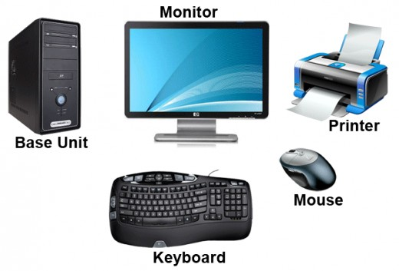
Parts of the computer

Slide 3
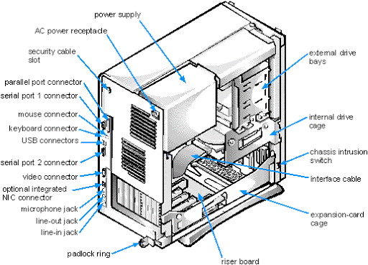

Slide 4
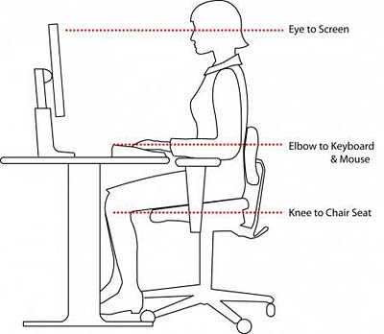
Computer posture

Slide 5
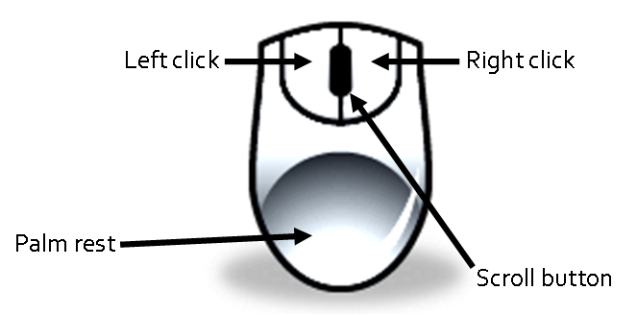
Computer mouse

Slide 6
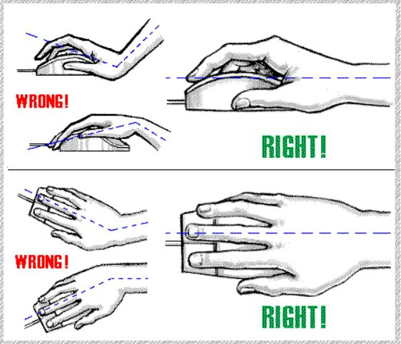
Mouse posture

Slide 7
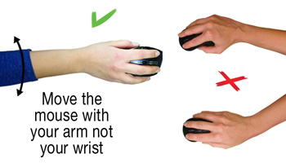
Mouse movement

Slide 8
QWERTY keyboard

Slide 9
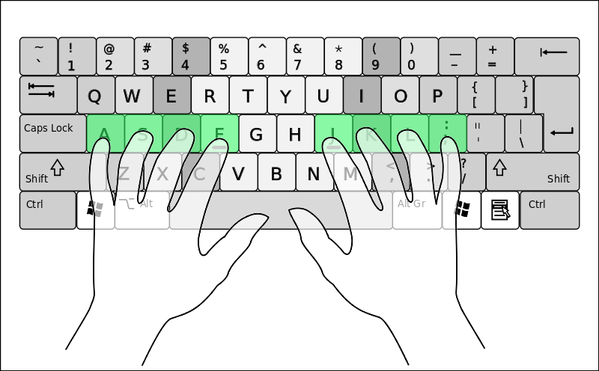
Qwerty finger placement

Slide 10
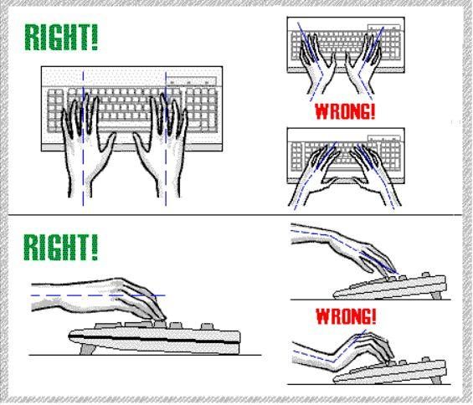
Keyboard hand posture

